Slide 1
Business Value:
Determining a Future Red Hat Customer
Predicting Red Hat Business Value: Classify Customer Potential

Slide 2
Meet the Team
Colby Meline
Paul Wen
Yu-Ting (Judy) Chen
Samuel D’Avila

Slide 3
Minimum Presentation Time

Slide 4
Table of Contents
Business Problem
3 Approaches
A, Naive Numerical Conversion
B, Random Forest
C, Stacking Classifiers
Closing Remarks

Slide 5
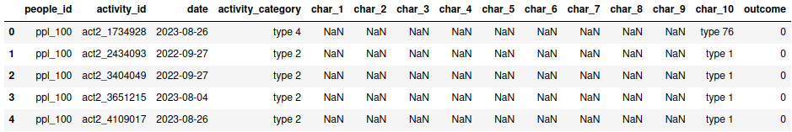
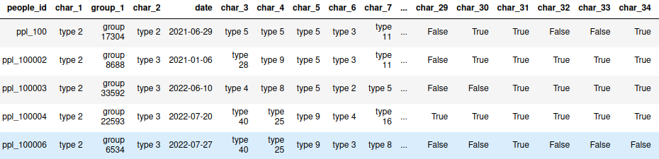
Approach A: Naive Numerical Conversion
A quick look at the data
Notes:
Every single row in the activity_train data (top) has at least one missing value.
Not a single row in the people data (bottom) has a missing value.

Slide 6
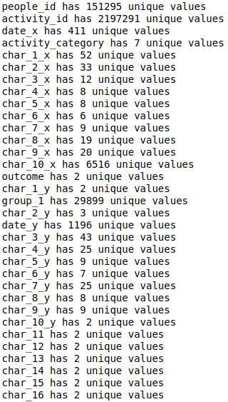
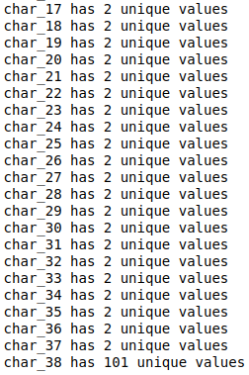
NNC p.2
A quick breakdown of unique values per column
Notes:
As you can see, every single column (aside from activity_id, which is a primary key) is a discrete column. There are roughly 2 million rows, and none of the columns comes close to having a unique value in each row.
None of the columns are clearly interpretable.

Slide 7
NNC p.3
As you can see, the data contains a MASSIVE amount of dimensions when considering the categorical data.
How do we deal with this?
One-Hot Encoding?
Requires a HUGE memory allocation, impossible to do for most single computers
Any model fit to the data may become virtually uninterpretable
Notes:
Even if you think, “Colby, 21 GiB isn’t that huge, you could pay for a cluster to manage that much data”, I think it’s valuable to think about ways you might tackle this problem anyway. What if you work at AT&T and the dataset you’re working on needs 21 petabytes of data allocation to get dummies? Your boss might not be on board with your, “Just spin up a cluster!” idea.

Slide 8
NNC p.4
What if we just treat categorical data as numeric?
Sounds stupid, but works much better than you may think
Each categorical variable already contains a unique numerical identifier
people_id
'ppl_100' -> 100
'ppl_100002' -> 100002
…

Slide 9
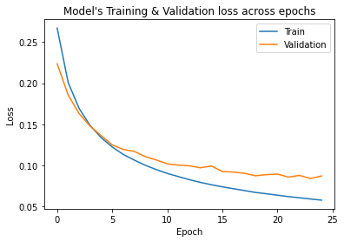
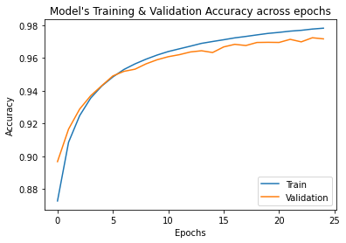
NNC p.5
After doing some relatively straightforward data transformations, I was able to train a Catboost model with 87% accuracy on training data, and 87.2% accuracy on unseen (test) data.
Additionally, a (relatively) simple Keras Neural Network achieved 98.5% accuracy on training data, and 97.3% accuracy on unseen (test) data.
These results seemed shockingly good, so I dug a little bit deeper…

Slide 10
NNC p.6 - Data Leak
After doing a little bit of digging, I discovered that a large portion of the dataset consisted of completely duplicated data.
Artificially inflated “test” scores
Removing these duplicates led to a slight decrease in the overall performance of both the tree-based models, and the neural network.
Notes:
Roughly 2% drop in accuracy across the board.

Slide 11
NNC p.7 - Future Plans
How would I approach this problem as an actual RedHat employee?
Models with SGD
Increased focus on data as time-series
LSTM or other RNN
Transformer Model
Streaming data into model using Apache Spark / Kafka
Notes:
Imagining that this problem is not just a Kaggle competition, how would we want to move forward / develop our solution?
Stochastic Gradient Descent - If this data is generated from user actions on a website, we want to be able to shape our model continuously over time without retraining on the entire dataset each time.
Time-Series - Many users in this dataset perform a variety of different actions over time. Considering previous actions of a person (if any) may result in a model with greater predictive power.
Streaming - Considering RedHat as a relatively large company, it seems likely that this data is being generated at a high velocity, continuously. A true solution to this problem should be able to train and predict using streaming data, which makes Spark / Kafka strong candidates.

Slide 12
NNC p.8 - The Kaggle Problem
Kaggle is a little bit stupid.
The competition setting incentivizes predictive power over everything else
Efficiency
Interpretability
Spirit of the Problem
The Power of
If -> This
Else -> That
Notes:
Kaggle competitions fail to take into account many relevant features of a true machine learning / data science solution. How efficient is your model? How interpretable is your model? Does using your model to solve this problem “in the real world” make sense? None of these things matter on Kaggle. At least, none of those things matter as much as how well your model separates the 1’s from the 0’s.
The #1 solution from this competition 6 years ago explicitly used an if-else statement in several parts of his predictive algorithm that predicted all members of certain groups as 0’s or 1’s. These if-else statements improved his AUC score. However, using this sort of approach would totally defeat the purpose of attempting to train a model which can predict whether a website visitor will or will not become a customer.
Leaderboard probing

Slide 13
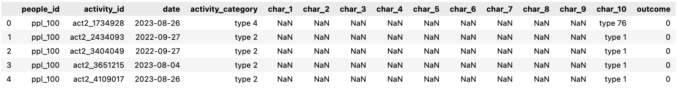
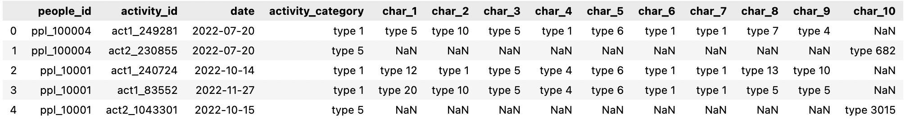
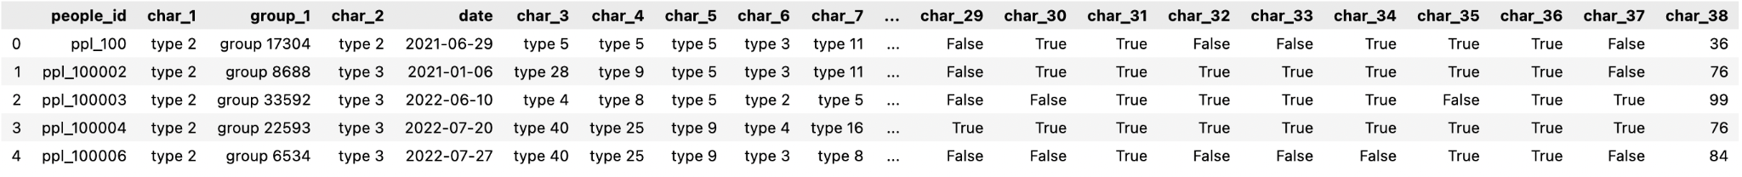
Approach B: Random Forest
Notes:
Just as Colby mentioned before, basically none of the columns in the datasets has a unique value in each row, so the data are not really interpretable.

Slide 14
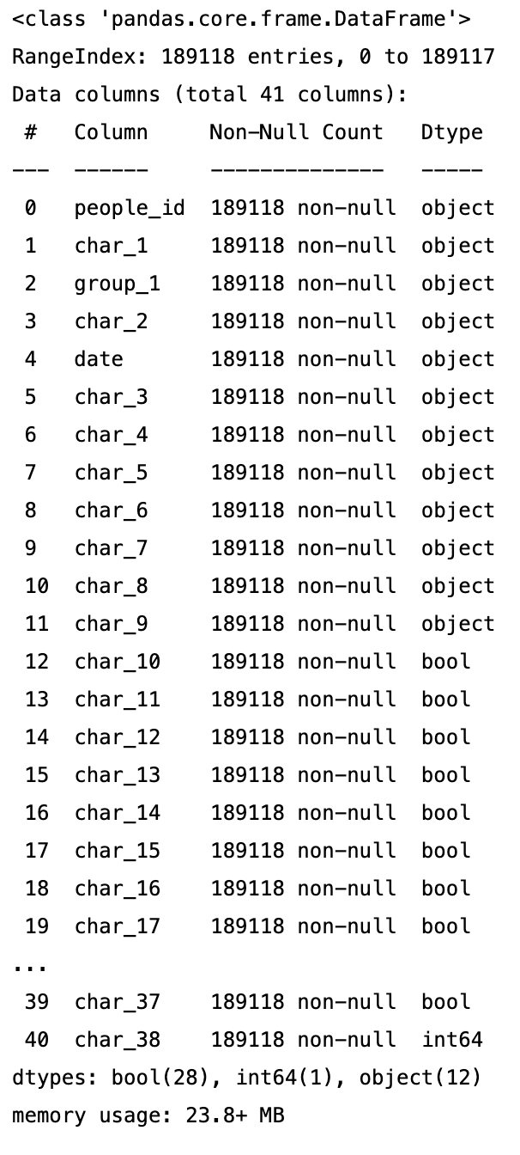
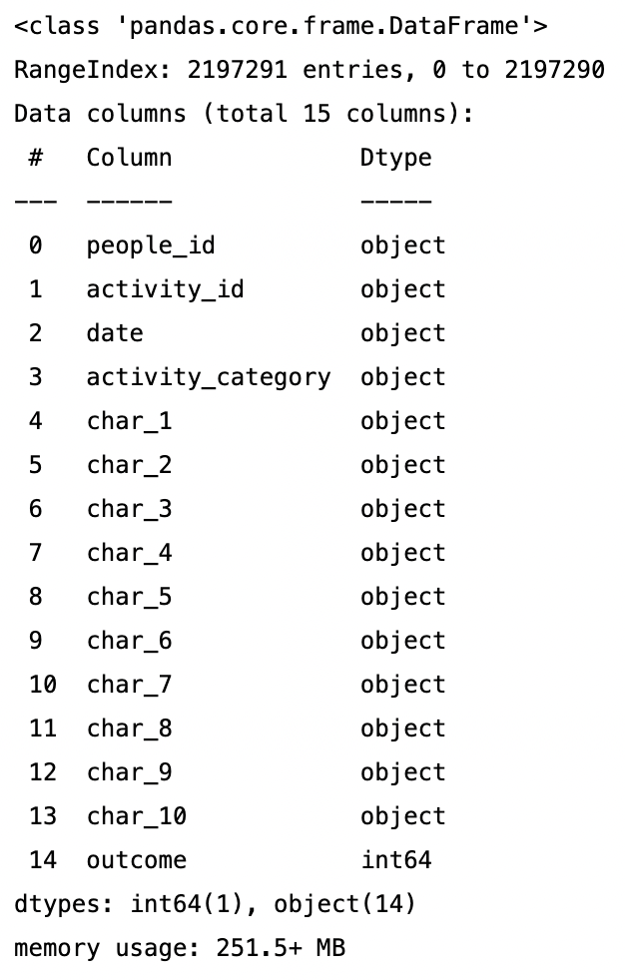
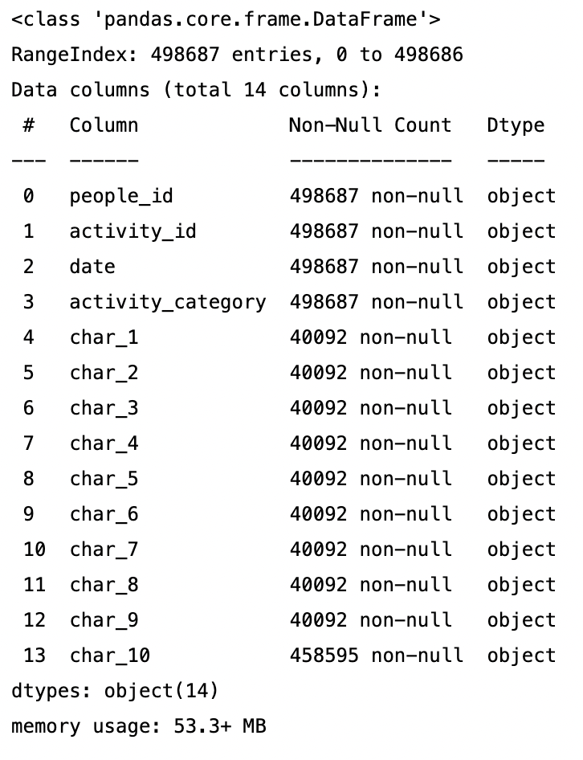
RF - Data Types
Notes:
We can see that most of the data types in these datasets are “object”, so we need to transform the text values into numbers.

Slide 15
RF - Data Preprocessing
Convert categorical data to numerical data
Convert features in people and activities into integers
Merge everything into a single unified table
Make it easier to drop into classifiers in Sklearn
Notes:
So the first thing to do is the data preprocessing.

Slide 16
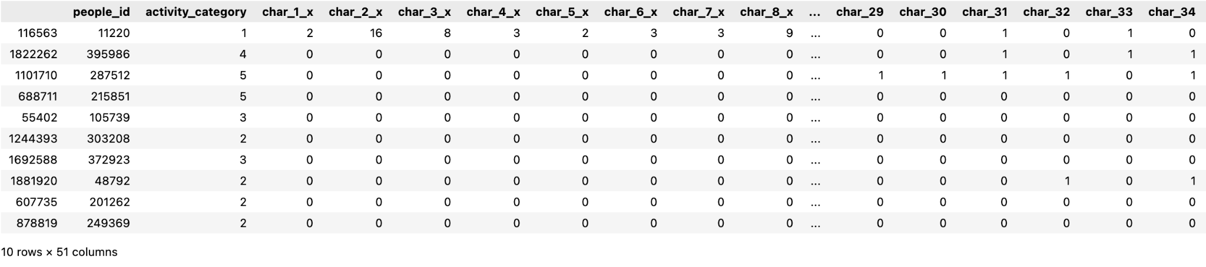
RF - Merging People and Activities
Notes:
As you can see, this is the merged table which combines everything together.
And now the data are all converted to numeric values, so we can start using Random Forest.

Slide 17
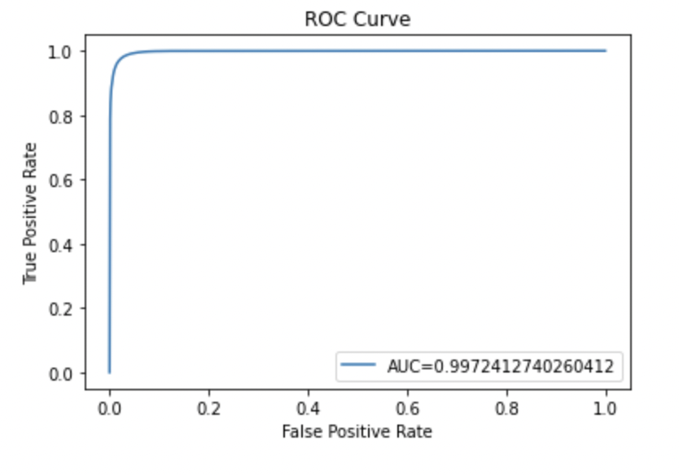
RF - Training a Random Forest Classifier
Import the Random Forest Classifier and create the model
After training the RF model, it got an AUC score of 0.9972412740260412.
Notes:
So next we will train the random forest model.

Slide 18
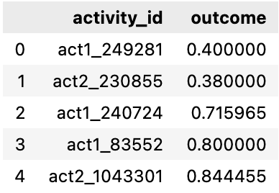
RF - Prediction Outcome for Kaggle
Identify which customers have the most potential business value for Red Hat based on their characteristics and activities
Predict a probability for the “outcome” variable for each activity_id in the test set, represented by a number between 0 and 1
Notes:
Last, this is the prediction outcome that we generated.
Since we want to identify which customers have the most potential business value for Red Hat, we predicted a probability for the outcome column for each activity_ID.

Slide 19
RF - Future Plans
Check for overfitting and testing leakage
Try other approaches and models
Notes:
If we have more time on this project, we might want to check if there are issues of overfitting and leakage and try to deal with it.
And we will also want to try other approaches as well.
SGD might be a good idea

Slide 20
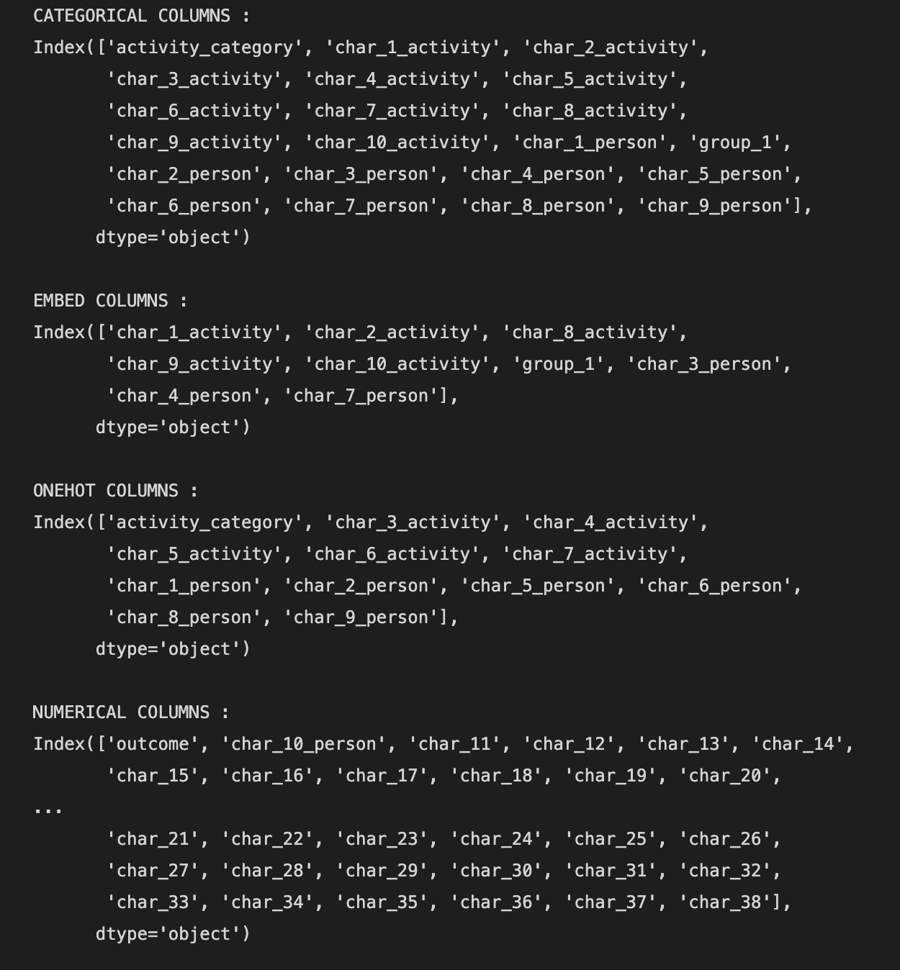
Approach C: Stacking Classifier
Seeking to take a good model and make it better
Building out with an XGBoost model on-top of the Keras

Slide 21
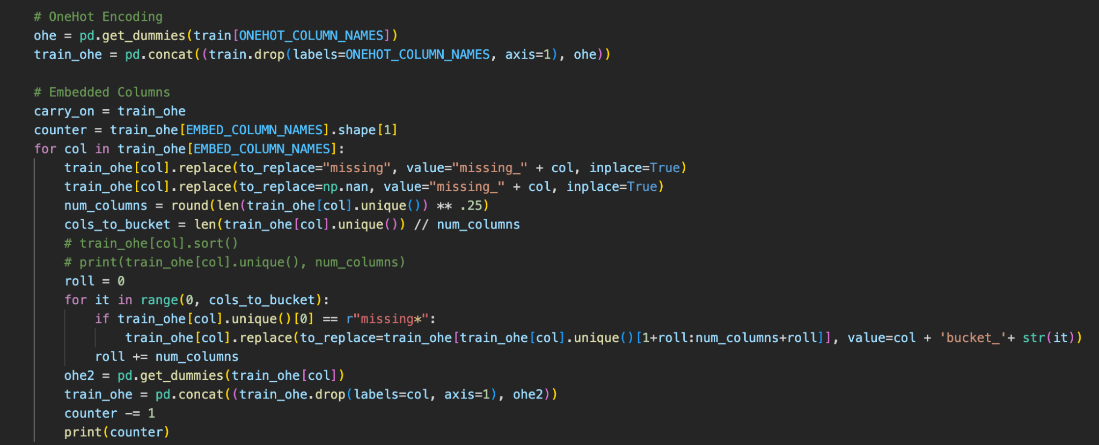
SC - Our Problem…

Slide 22
SC - Results
Accuracy: ~75% with XGBoost
Non-Embedded!
Plan going forward
Optimize code so it can run
Or run it on a smaller sample…
Employ a CNN with XGBoost

Slide 23
Questions?
Thank you for your time!

